Slide 1
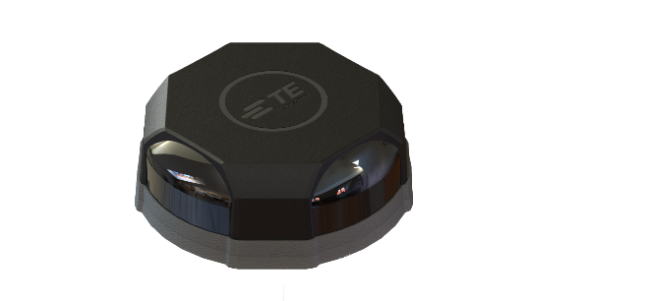
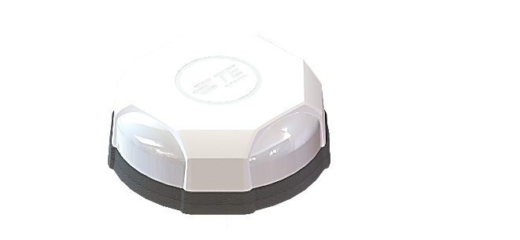
FP40 ultra 4x4 MIMO Multi-Port Antennas Up to 14 ports: 4x 4G/5G 8x WiFi 6E / WiFi 7 1x GNSS 1x Bluetooth
Customer Presentation

Slide 2
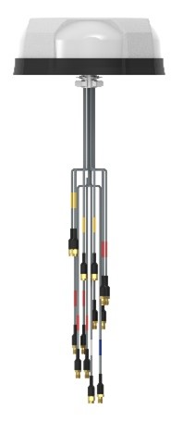
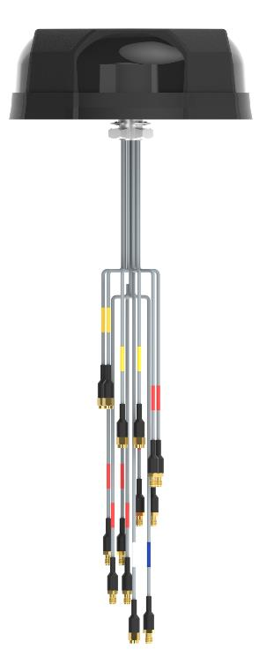
FP40 ultra - 4x4 MIMO Multi-Port Antennas
FP40 ultra is a family of 4X4 MIMO next generation, multi-port antennas.
Designed for intelligent transportation, freight, utility and public safety applications.
Key benefits:
Supplied as a kit along with the appropriate extension cable
Configurations available up to 14-port
Coverage of all LTE/5G bands, Wi-Fi 6E, Bluetooth and GNSS
Future-proof global 4G and 5G coverage

Slide 3
Key Features and Benefits
Configurations available up to 14-port incorporating next-generation technology
Coverage of all LTE/5G bands (617-7125 MHz), Wi-Fi 6E, Bluetooth and GNSS
Designed for applications demanding the highest data rates and lowest latency
Future-proofed against future 4G/5G frequency rollouts up to 7125 MHz
Industry-Leading Performance
Configurable
14 Ports : 4x 4G/5G; 8x Wi-Fi 6E; 1x GNSS (L1+L5); 1x Bluetooth
Compatible with all major router and gateway products
Customizable connector, cable length and port configurations
R118 compliant cables qualified for “burn behavior” come standard
Optimal height at only 66mm tall: Balance between aesthetics plus strong signal coverage
L1 and L5 GNSS for improved positioning accuracy and response times
Out of band rejection filters maintain consistent performance
High data throughput is enabled by technologies such as carrier aggregation
Superior gain patterns, low gain ripple, high gain at horizon and efficiency of over 70%
UV, Flammability, Humidity, Impact, Vibration, Shock certified
Made in Malaysia
Engineered for Performance

Slide 4
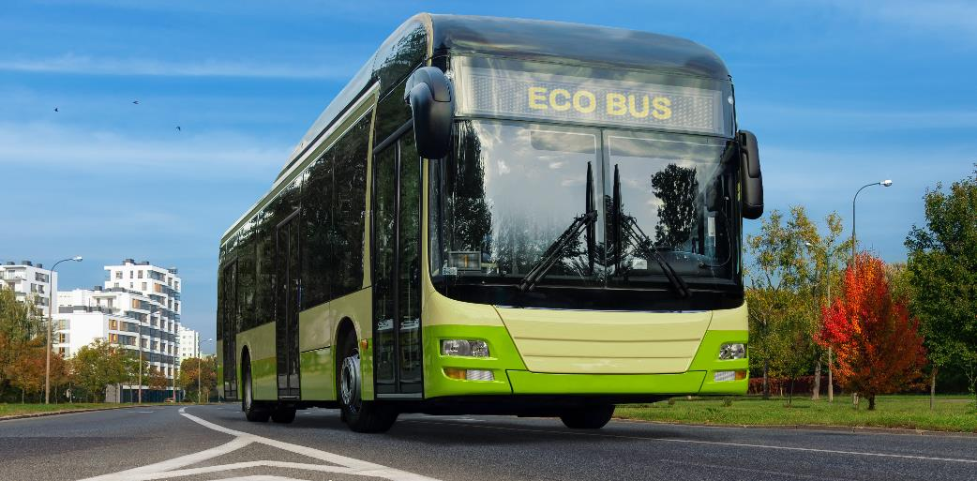
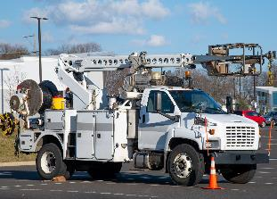
Key Applications
Primary Industry
Intelligent Transportation
Applications
Public Transportation
Coaches
Public Safety
Utility Vehicles
Freight / Commercial Transportation

Slide 5
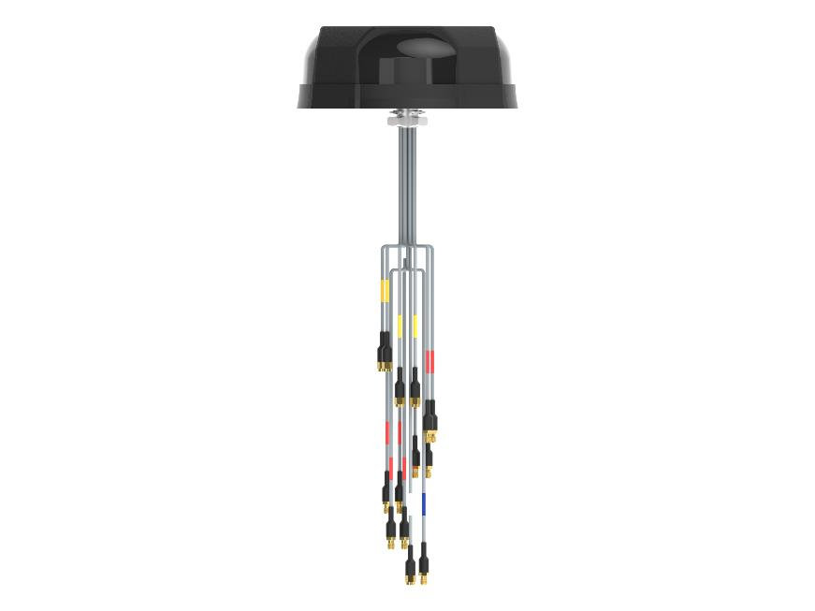
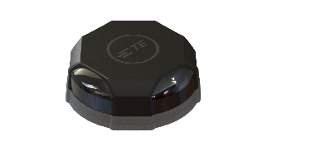
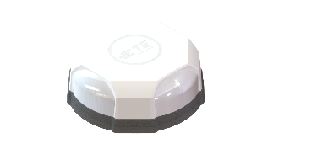
FP40 ultra Overview
FP40 ultra is a family of 4X4 MIMO next generation, multi-port antennas. Designed for intelligent transportation applications including public transport, freight and public safety applications.
Configurations available up to 14-port incorporating next-generation technology
Compatible with all major routers and gateways
Coverage of all LTE/5G bands (617-7125 MHz), Wi-Fi 6E, Bluetooth and GNSS
Supports B11, B32, B21 in 1450 MHz range, for Europe and Japan, many competitors do not support !
Designed for applications demanding the highest data rates and lowest latency
Future-proofed against future 4G/5G frequency rollouts up to 7125 MHz
Many competitors don’t support above 6GHz.
We have a new Anechoic Chamber in Malaysia that specifically supports this !
Pricing: We’re typically positioned below the popular brand demanded by transit and police agencies.
Extended Coverage Global LTE, Wi-Fi 6E and GNSS from a single antenna
Rugged and Tested UV, Flammability, Humidity, Impact, Vibration, Shock certified
Optimized Gain High gain at horizon; minimal ripple 360 degrees around antenna.
Result = fewer drops !
Versatile Options to suit all major router and gateway port configurations
Port Options Multiple options available up to 14 port configurations
Color Options Available in black or white

Slide 6
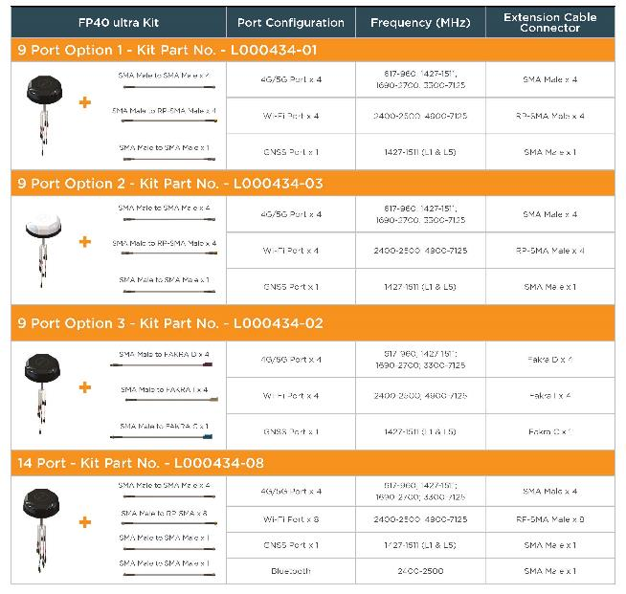
FP40 ultra Kit Landing Pages
FP40 ultra is supplied as a complete kit along with the appropriate extension cable in order to meet the port requirements of major vehicular gateways and routers. Our handy configurator guide shows the antenna, extension cable and connector options available with each kit as shown below:
4 Port Kit
8 Port Option 1 Kit
8 Port Option 2 Kit
8 Port Option 3 Kit
9 Port Option 1 Kit
9 Port Option 2 Kit
9 Port Option 3 Kit
14 Port Kit
FP40 Ultra Kit Configurator and Datasheet

Slide 7
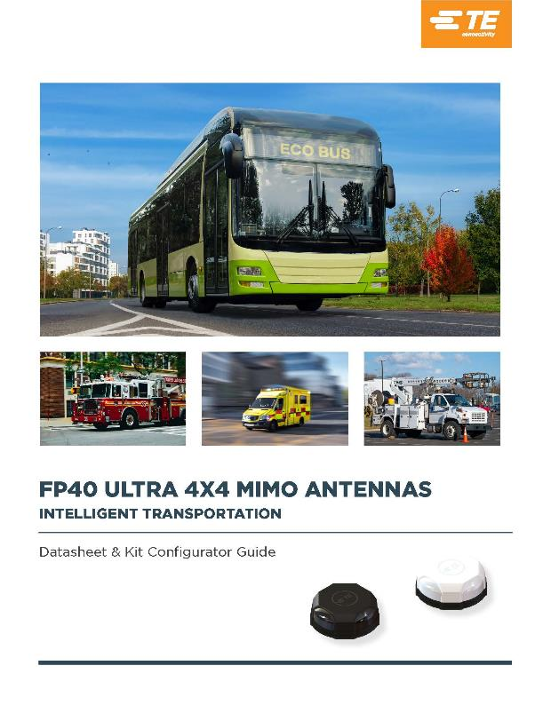
Online Resources
Online Resources:
Datasheet and Kit Configurator Guide
Assembly & Installation Manual
Product Management
Paul Fadlovich
Sr. Manager, Product Management, External Antennas
Paul.Fadlovich@te.com

